Slide 1
The Missing Semester of Your CS Education
API Usage

Slide 2
API? What’s an API?
Application Programing Interface
A set of protocols for interacting with a particular software
Typically used to programmatically interface with a piece of software, allowing for automation or expansion upon its basic capabilities
Although API can refer to any interface created by the developers of any software, it is most commonly used in reference to the method of communicating with webservers over HTTP.

Slide 3
HTTP
Hyper Text Transfer Protocol
The foundation of all data exchange on the internet
Allows for clients to request a “resource” from the server, and for the server to send the resource back to the client
Provides a simple framework for how client-server communications should take place, but does not provide a format for what should be within those communications

Slide 4
REST
Representation State Transfer
An architectural style for developing APIs, currently the most popular and commonly seen
Five simple constraints of the REST API System:
Client Server Architecture
Statelessness
Catchability
Layered System
Uniform Interface

Slide 5
Why Use An API
APIs are typically offered by web applications as an alternative to using a GUI interface
Allows for programmatic interactions with a website
Offers opportunities to tie completely unrelated web services
Example: Downloading scan reports from one web service to be uploaded to another web service for parsing and analysis
Many web services offer the ability to collect data through an API

Slide 6

API Request Types
HTTP Request Type | CRUD Operation
GET | Read
POST | Write
PATCH/PUT | Update
DELETE | Delete

Slide 7
API Authentication
Simple Auth:
Username and password combination
Bearer Token Auth:
A single API token or “key” is used for authentication by a user
JWT:
JSON Web Token authentication
Generated by the backend API, and given to the user, typically with a relatively low time before expiration. Often a new JWT is required for each session

Slide 8
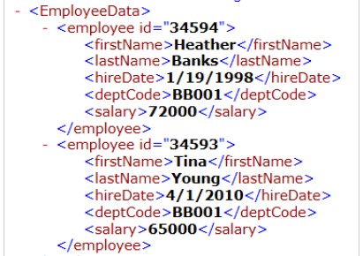
Data Structures - XML
Extensible Markup Language
Used by many older APIs
Good for a structured response, and when data needs to be able to be easily rendered by a browser
Difficult to parse in many languages; not used much anymore due to this

Slide 9
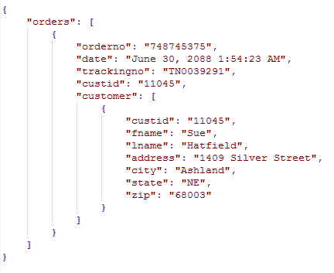
Data Structures - JSON
Java Script Object Notation
Similar to a dictionary in Python
Most modern APIs make use of this structure
Much easier than XML to interact with in most programming language

Slide 10
API Responses: Success
200: Successful response, typically accompanied by date returned from the API, often from a GET or POST
201: Created. Typically returned by POST requests.
204: Successful, but no content. Typically returned in response to PATCH, or DELETE requests, where nothing needs to be returned

Slide 11
API Reponses: Failure
400: Bad request. A malformed request was received
401: Unauthorized: Client is not authenticated
403: Forbidden: Client is authenticated, but not allowed to access resource
404: Resource not found
405: Method not allowed. Ex. Sending a POST to an endpoint that only accepts GET
500: Internal Server Error

Slide 12
Postman
A GUI Tool for making API requests, testing APIs, and assisting with API development
Autogenerates code snippets in a variety of languages
Automatically syntax highlights requests and responses
Supports environment variables for secrets and environment specific values

Slide 13
Getting Started With Postman
Import the provided Postman collection and Postman environment files into postman
Edit the environment, and add your API key

Slide 14
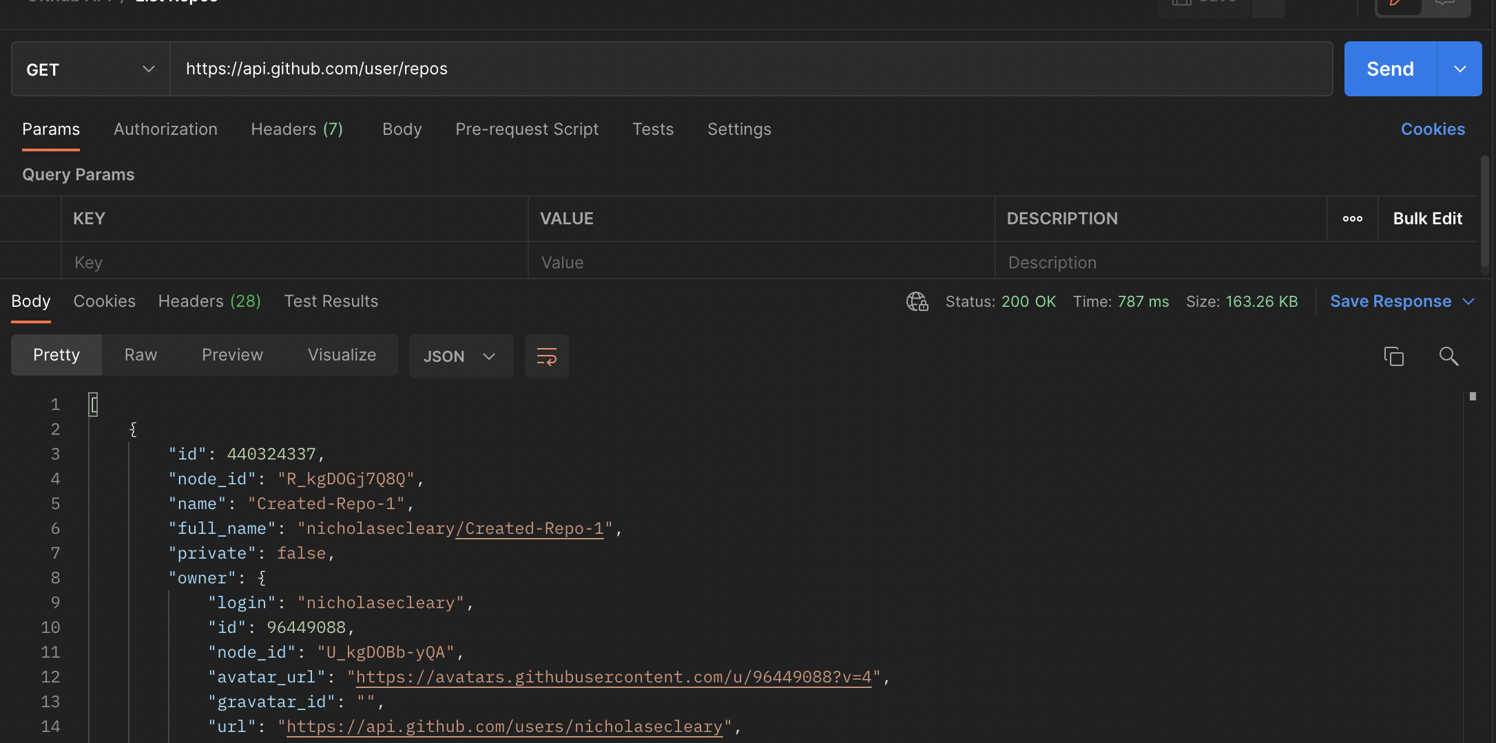
Your First Request
Create a new request in the collection, and enter the URL https://api.github.com/user/repos
This will send a GET request to Github, and retrieve a list of the repositories belonging to the authenticated user
What is retrieved is a list of the first 10 of our repositories

Slide 15
Query Parameters
Oftentimes we want to limit our results, not just blindly return all objects of a certain type
Query parameters allow us to specify things like
Number of objects to return
The offset or page number of objects to return
Server defined search filters. This could be something like “is repository private” or “is repository older than X days”
Added in a url in the following format:
http://api.com/object?Key1=Value&Key2=Value2

Slide 16
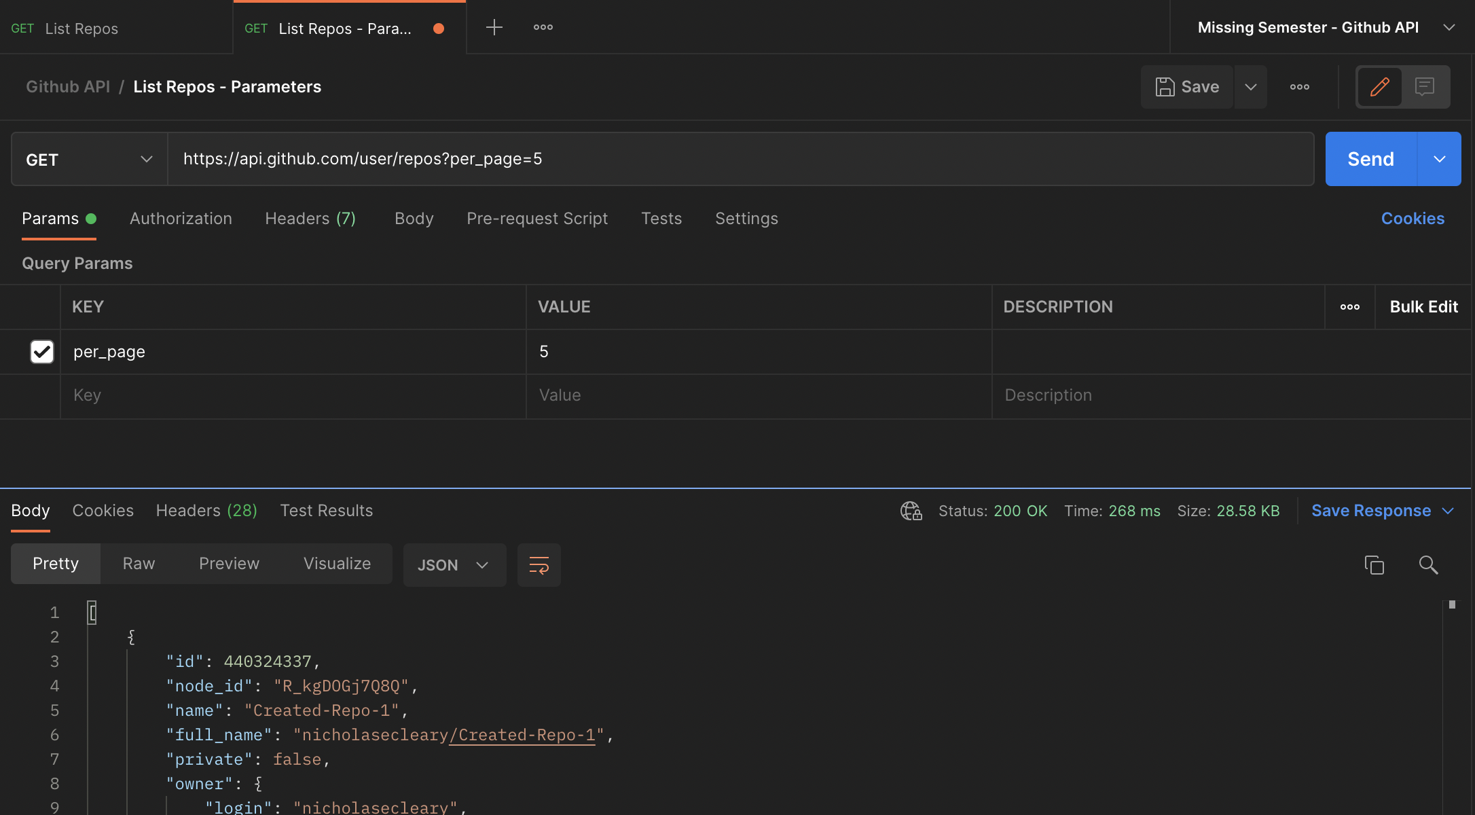
Using Query Parameters
Let’s limit the number of results we receive from github
Under the URL box, postman has a Query Params field
In this, enter ”per_page” for the key, and 5 for the value
Send another request
Notice we receive far fewer values in response

Slide 17
Creating Objects
Many APIs allow you to create an object on the server
This is done with a POST request
A post request typically has a body supplied by the user, containing information about the object to be created
In most modern APIs, this body is written in JSON

Slide 18
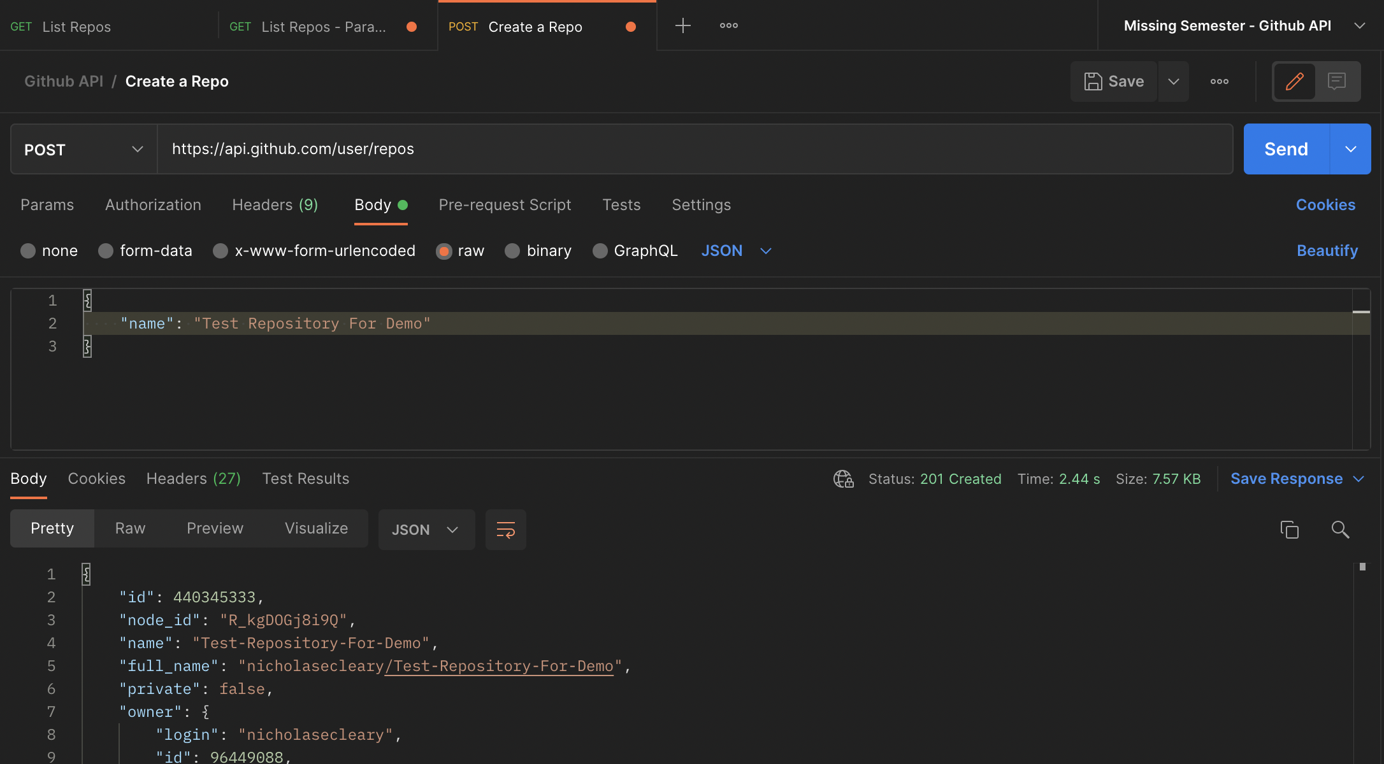
Creating a Repository
Let’s create a Github Repository
Create a new request, set its type to POST, and point it to https://api.github.com/user/repos
Under the body field, select “RAW”, format it as JSON, and specify a name file of anything you like, as seen in the screenshot

Slide 19
URL Parameters
Oftentimes, we need to specify a what particular object we want to receive in an API response, or what object we want to update
This is where URL parameters come in; these are unique identifiers in the URL that specify where which exact object we are making an API request about
In this example:
api.com/objects/123
The “123” is our URL parameters, which tells the API we are making a request specifically about object 123

Slide 20
PATCH Requests
PATCH requests are made to update a particular resource which already exists on the server
Typically, a body is specified, but only the fields which are to be updated are included

Slide 21
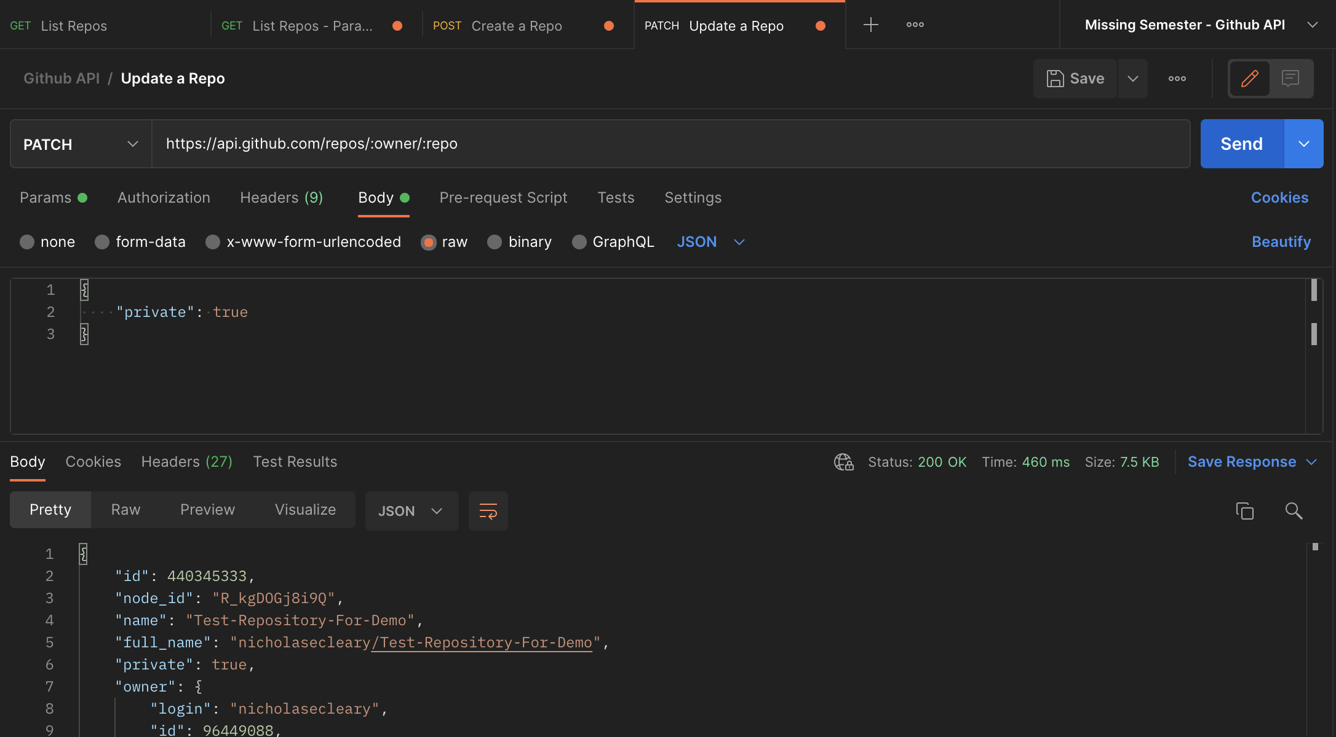
Updating Our Repository
Copy the username and repository name from the previous request into a URL in the following format:
https://api.github.com/repos/username/repo_name
In the body, set a field “private” to true, as seen here
Our repo is not private

Slide 22
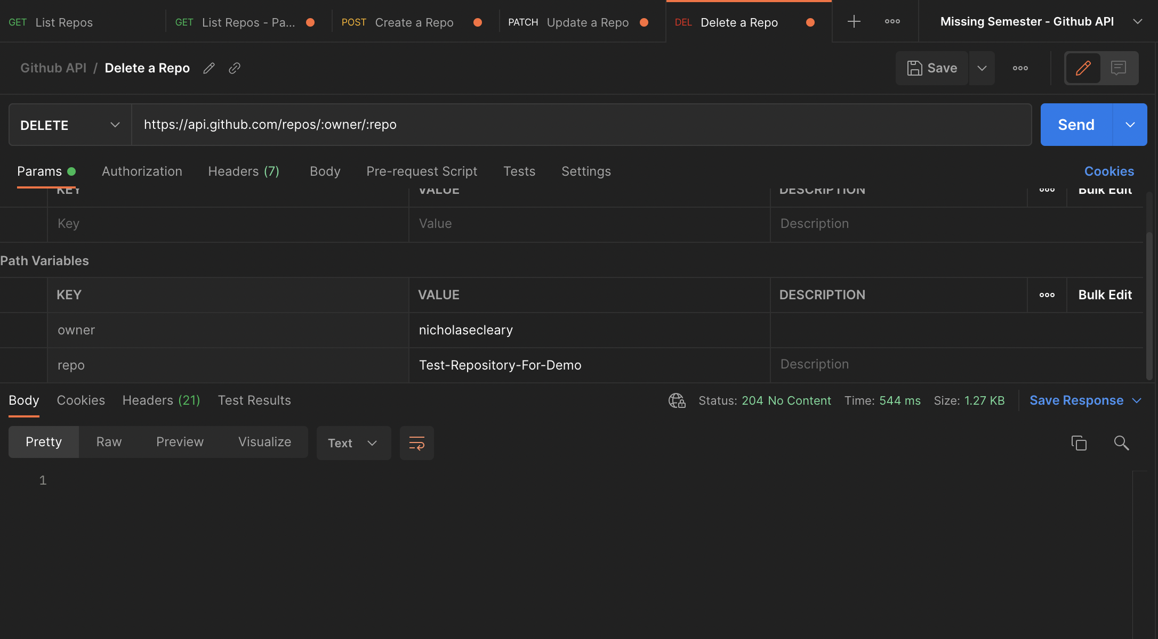
Deleting Our Repository
Create a new request, set its type to DELETE, and copy the URL from the previous request
Time to say goodbye to our repository—this request will delete it
Notice the 204-response code—there’s nothing for the server to return here except for a successful status

Slide 23
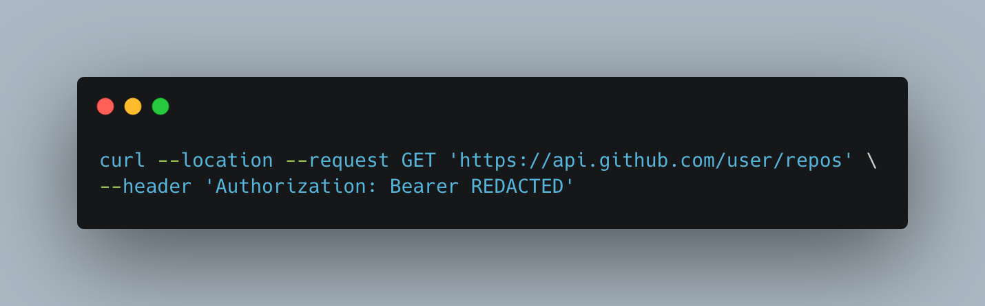
Making Requests from a Terminal
Use a utility called “curl”, which serves as a command line API client
Useful for making API requests in a script
Postman can autogenerate curl requests

Slide 24
API Requests With Python
To make API requests with python, we will be using the requests library
Install (on Unix systems) with ”pip3 install requests”

Slide 25
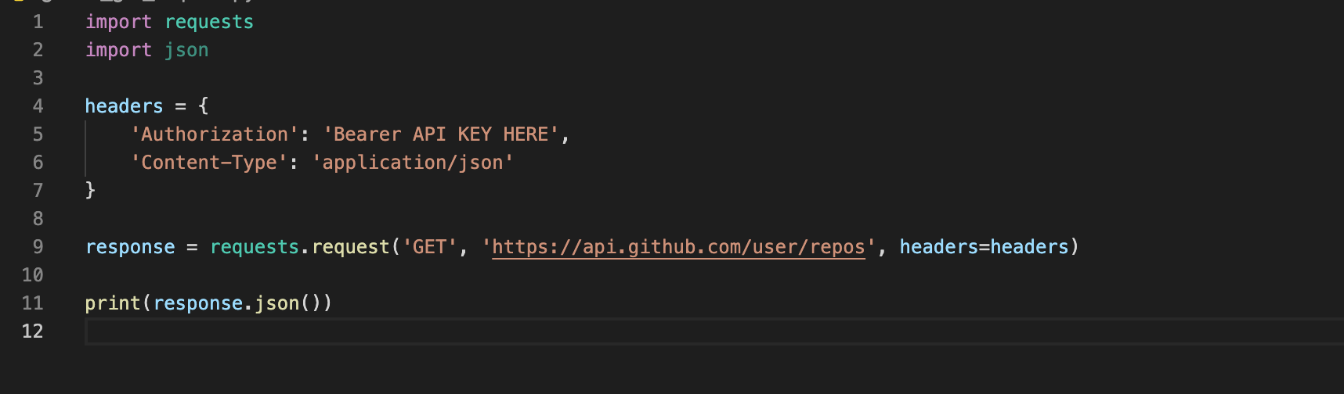
Get Request With Python

Slide 26
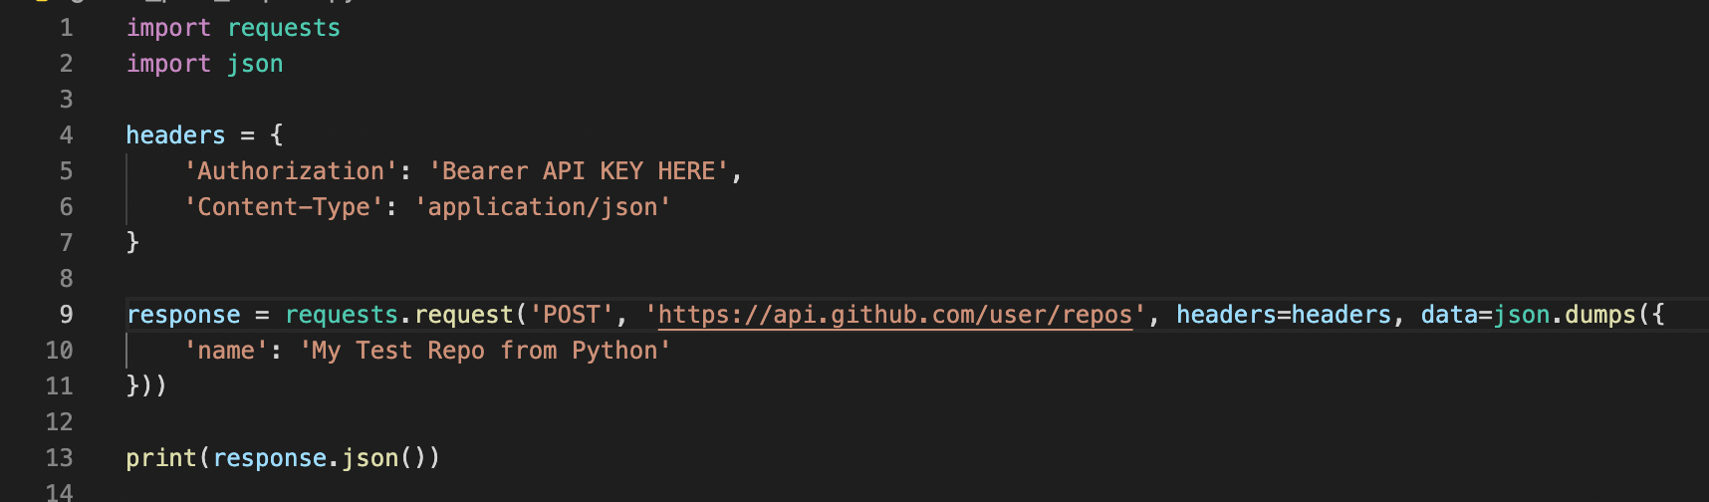
Post Request with Python

